Slide 1



Healthy EU
2016-1-FI01-KA201-022772

Slide 2
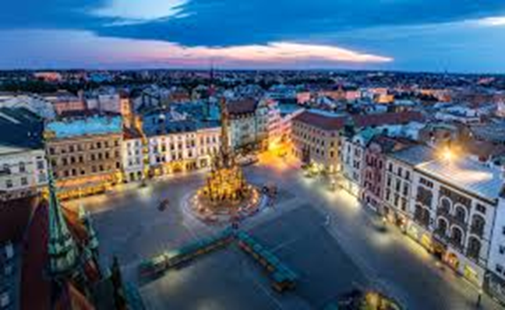
Olomouc

Slide 3
Olomouc
Olomouc – the second largest urban reserve (after Prague)- is exceptional in its concentration of churches, chapels, palaces and monasteries within a walk-distance location. There are sights from all historic periods and architectural styles.

Slide 4
OLOMOUC – CENTRE OF THE REGION
Administrative centre of the region
Located on the Morava River,
The sixth largest city in the Czech
102,000 residents
The ecclesiastical metropolis (the seat of the Archbishop)and historical capital city of Moravia.
Second largest urban reserve (after Prague)- is exceptional in its concentration of churches, chapels, palaces and monasteries wirhin a walk-distance location.

Slide 5
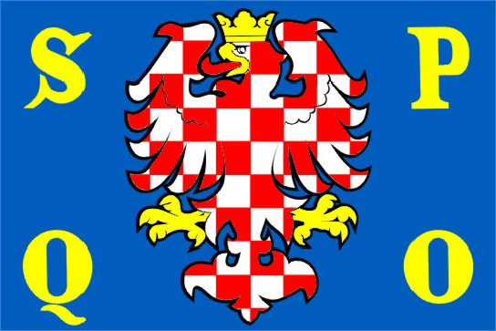
FLAG OF OLOMOUC
SENATUS POPULUSQUE OLOMOUCIENSIS
Zdroj: [cit2014-04-22]. Dostupný pod licencí public domain
http://upload.wikimedia.org/wikipedia/commons/e/e1/Olomouc_flag.png

Slide 6

Monuments
Olomouc contains several large squares, the chief of which is adorned with the Holy Trinity Column, designated as a UNESCO World Heritage Site. The column is 115 ft (35 m) high and was built between 1716 and 1754.
The city has numerous historic religious buildings. The most prominent church is Saint Wenceslas Cathedral founded before 1107 in the compound of the Olomouc Castle. At the end of the 19th century, the cathedral was rebuilt in the neo-Gothic style. It kept many features of the original church, which had renovations and additions reflecting styles of different ages: Romanesque crypt, Gothic cloister, Baroque chapels. The highest of the three spires is 328 ft (100 m), the second-highest in the country (after Cathedral of St. Bartholomew in Plzeň)-

Slide 7
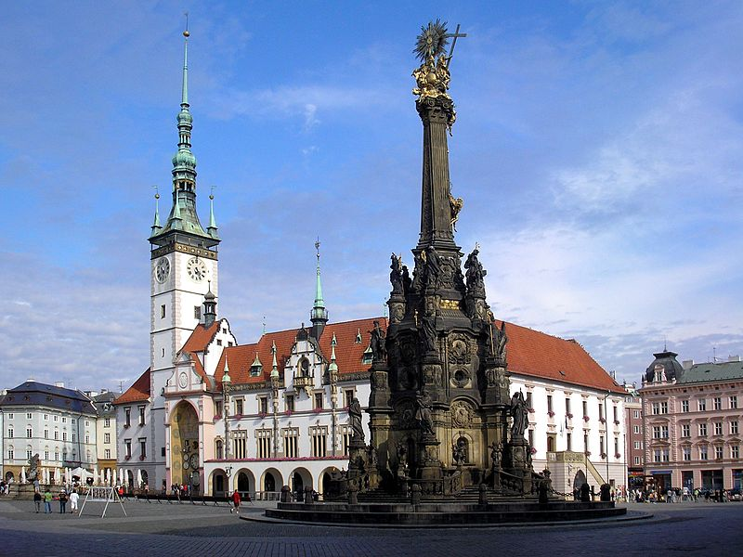
UPPER SQUARE, OLOMOUC
Zdroj: [cit2014-0-22]. Dostupný pod licencí public domain
http://upload.wikimedia.org/wikipedia/commons/thumb/9/9a/Olomouc-Horn%C3%AD_n%C3%A1m%C4%9Bst%C3%AD.JPG/800px-Olomouc-Horn%C3%AD_n%C3%A1m%C4%9Bst%C3%AD.JPG

Slide 8
SACRAL SIGHTS
There are sights from all historic periods and architectural styles.
  St. Maurice Church (Gothic )– houses the second largest organ in Central Europe
  St. Michael Church (Baroque st.),
  St. Wenceslas Cathedral (Noe-Gothic) – the dominant of the city with the tallest church spire in Moravia,
  Přemyslid /Bishop Palace – the oldest sight from Romanesque period
  Jesuit church of St Mary of Snow (Baroque) with an adjacent convent

Slide 9
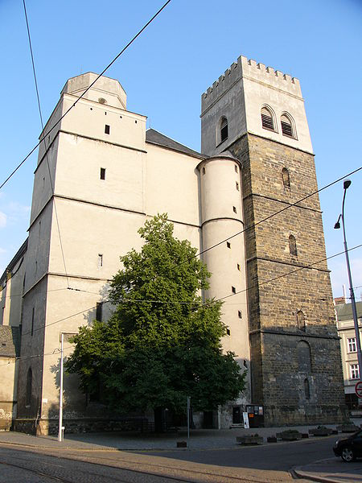
ST. MAURICE CHURCH
Zdroj: [cit2014-04-22]. Dostupný pod licencí Creative Commons
http://upload.wikimedia.org/wikipedia/commons/thumb/8/87/Chram_svateho_Morice_2.jpg/450px-Chram_svateho_Morice_2.jpg

Slide 10
BUILDINGS, PALACES, MONUMENTS
  Baroque monuments
    Holy Trinity Column (Baroque) – the UNESCO site
    Baroque fountains (Caesar, the Tritons, Hercules, Mercury, Jupiter, Neptune)
  Buildings and palaces:
    Town hall (Renaissance) with the astronomical clock (modern Socialist period)
    Edelmann´s Palace (Renaissance)
    Archbishop Palace (Baroque)
    The Přemyslid Palace (Romanesqu)
    Villa Primavesi (Art Nouveau)

Slide 11
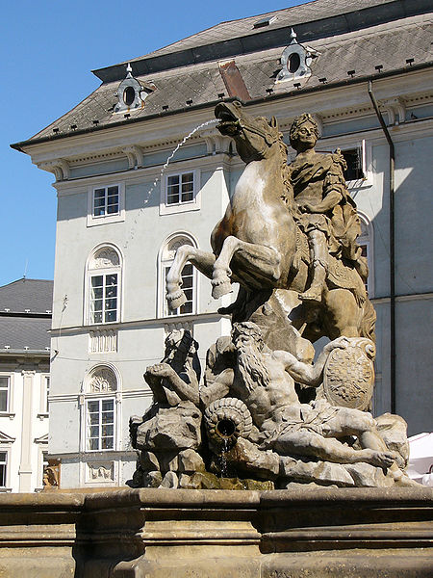
CAESAR FOUNTAIN, OLOMOUC
Zdroj: [cit2014-04-22]. Dostupný pod licencí Creative Commons
http://upload.wikimedia.org/wikipedia/commons/thumb/8/8c/Caesarova_kasna_detail.jpg/450px-Caesarova_kasna_detail.jpg

Slide 12
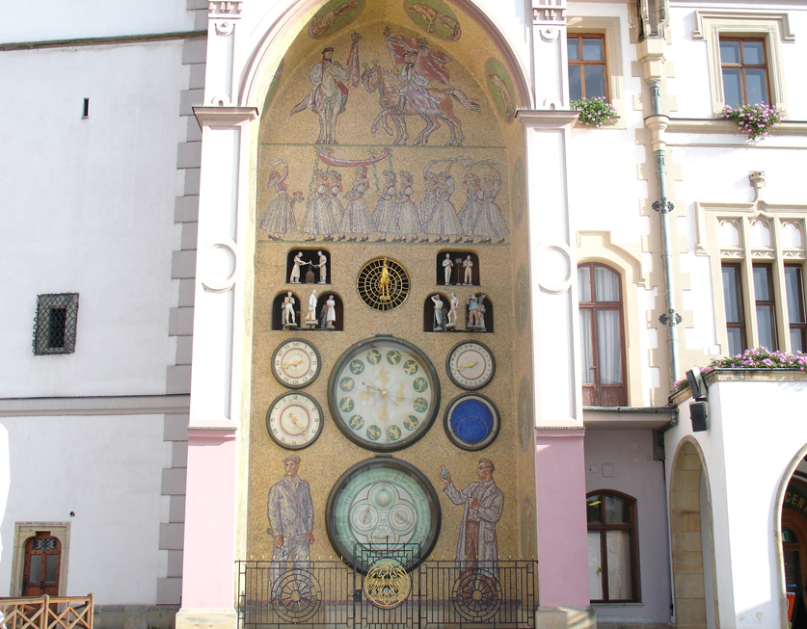
Astronomical Clock

Slide 13
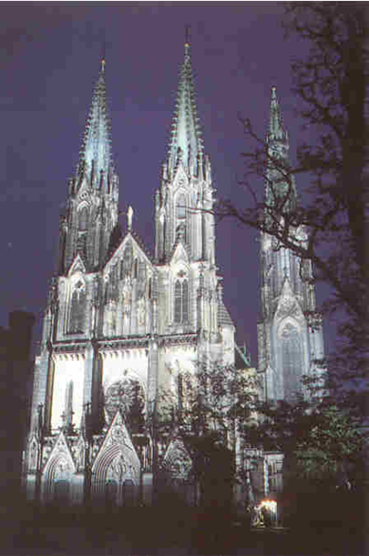
St. Wenceslas Cathedral, Přemyslid Palace
At the end of the last century
it was rebuilt in Neo-Gothic style.
Its big spire is 100 metres high.
In 1306 the last member of
the Premyslid family,
Václav the Third, was
murdered at the Olomouc
Castle.

Slide 14
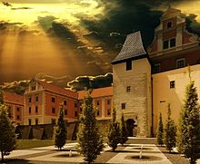
Palacky University
Olomouc is also an important centre of education and culture.
Palacký University with 7 faculties is the second oldest university in our country.
The university plays a very important role in the life of the town: With over 25,200 students (including those at Moravian College Olomouc), Olomouc has the highest density of university students in Central Europe. Many of the town's services are student-oriented. They close during holidays and the university exam periods. During the summer holiday, the trams run solo (apart from rush-hours), while during the university sessions, the lines are served by two coupled trams.

Slide 15
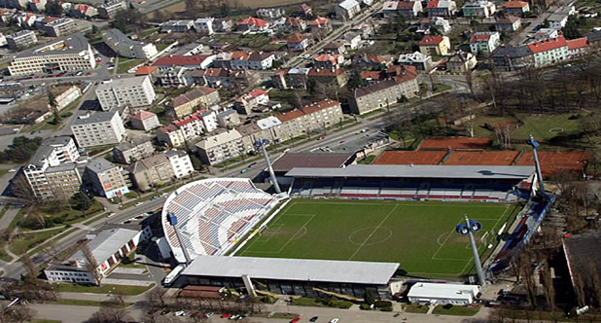
Sport in Olomouc
Olomouc is a centre for sporting life too. There are sports stadions, sports halls, swimming pools, tennis courts, ice rinks, gymnasiums, fitness centres.
The best-known sports clubs are HC that plays the first ice-hockey league, and Sigma that plays the first football league.

Slide 16

Sport
AK Olomouc – athletics club
Skokani Olomouc – baseball club
1. HFK Olomouc – football club
SK Sigma Olomouc – football club
DHK Olomouc – women's handball club
HC Olomouc – ice hockey club
VK UP Olomouc – women's volleyball club
RC Olomouc – rugby club

Slide 17
Other Tourist Destinations
The town of Jeseník – Priessnitz spa
Karlova Studánka – climatic spa
Svatý Kopeček village - well-known Pilgrimage Church of the Visitation of the Virgin Mary and the monastry (Baroque)
Scenic place: Dlouhé Stráně water reservoir on the top of the hill

Slide 18
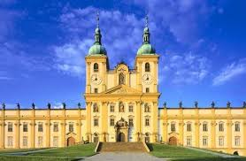
Svatý Kopeček

Slide 19
Nature and landscape
Protected landscape area Litovelské Pomoraví - many endangered kinds of plants and animals, many period river branches (protection against flooding water)
caves in the region: Javoříčko Caves , Mladeč Caves ,Zbrašov aragonite caves, Hranice Abbys – with the depth of 442.5m, the deepest abbys in the CR, the second deepest underwater abbys in the world
Landscape park of English style around Nové Zámky manor

Slide 20
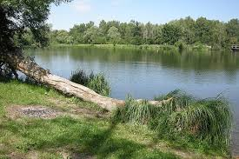
Litovelské Pomoraví

